Slide 1
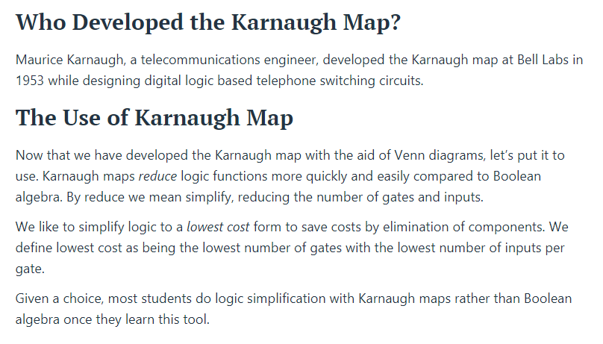
( Kaurnaugh Map )

Slide 2
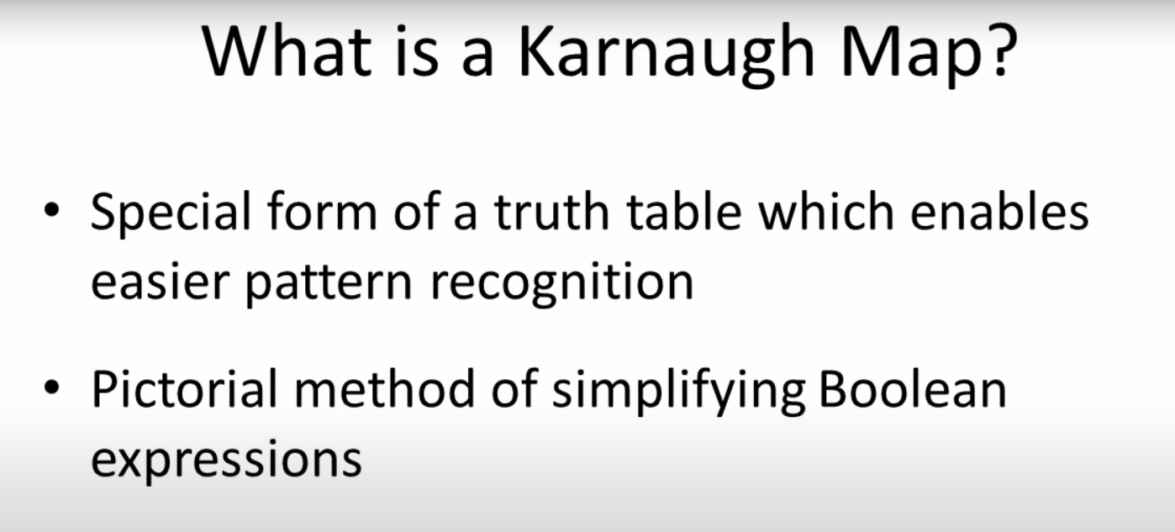

Slide 3
RULES FOR GROUPING
The group must be horizontal or vertical.
The group must be square or rectangle.
The group can never be in the L shape in any possible case.

Slide 4
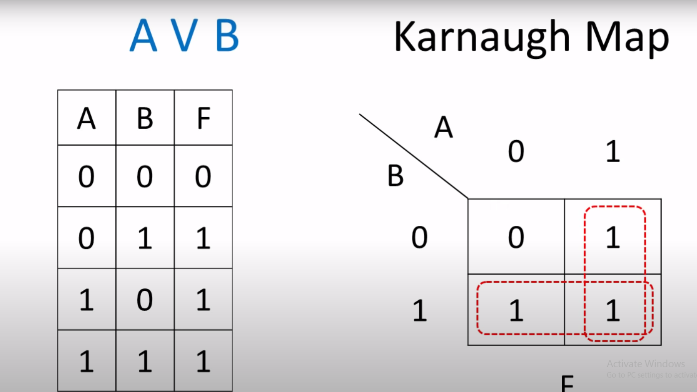
OR ( A V B ) Overlapping involved

Slide 5
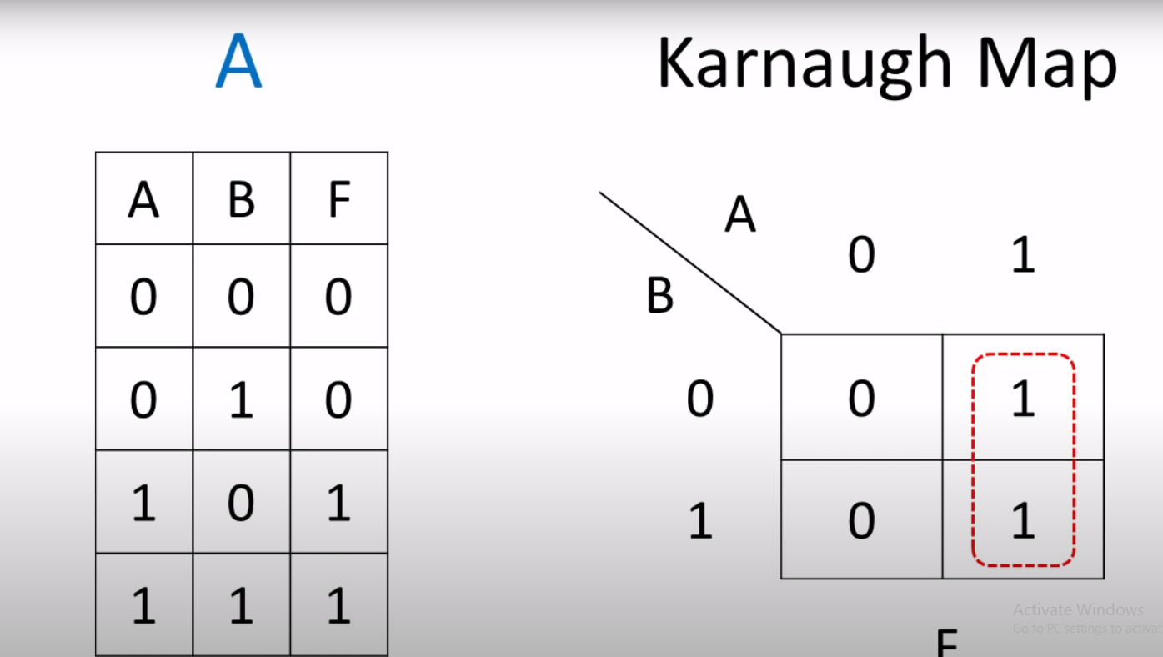
A group(Overlapping not involved)

Slide 6
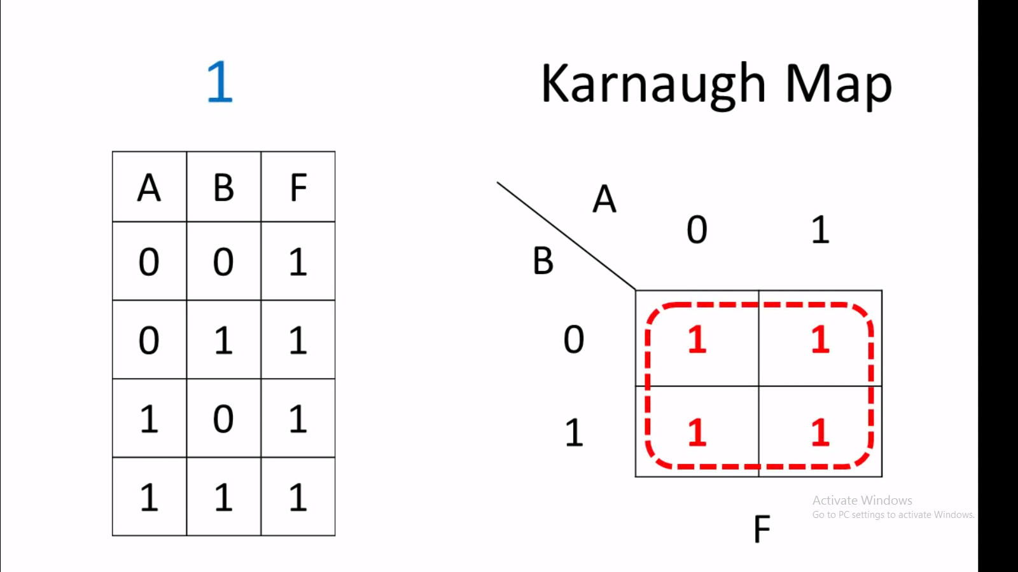
1(Overlapping not involved)

Slide 7
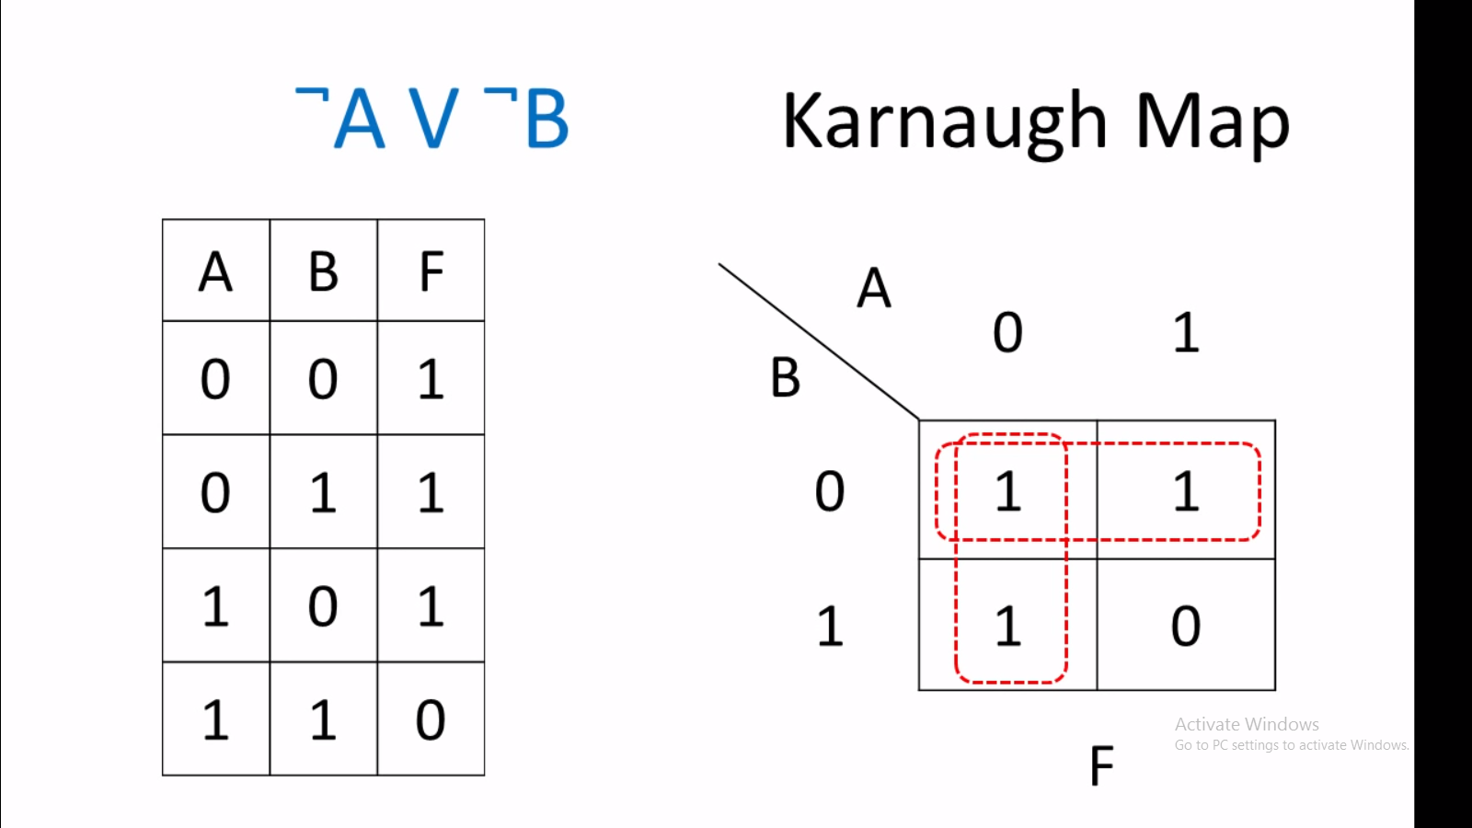
NAND (Overlapping involved)

Slide 8
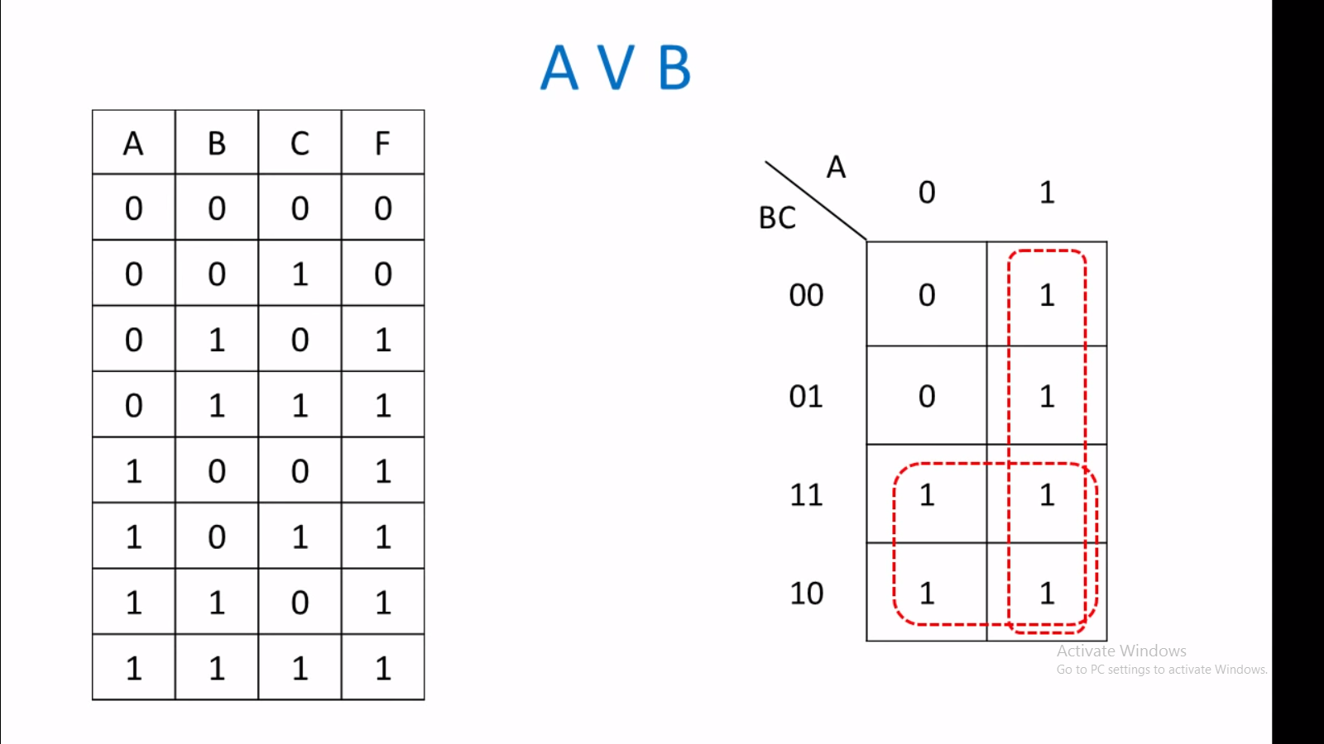
3 Variable KMAPS

Slide 9
Thanks for Learning with us! Presented by : Daniyal Farooq. Waqar Hassan. CR Mohsin.

